Slide 1
Security and Ethical Challenges
Management Information Systems

Slide 2
Security challenges
Computer crimes that exist in the present society are:-
Hacking
Cyber Theft
Unauthorized use at work
Software Piracy
Piracy of intellectual property
Computer viruses and worms

Slide 3
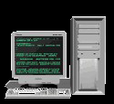

Hacking
Hacking is the obsessive use of computers, or the unauthorized access and use of networked computer systems. Hackers usually
Steal or damage data
Get unauthorized access to computer files
Monitor e-mails or web server access
May use remote services that allow one computer to execute programs on another
Plant data that will cause system to welcome intruders

Slide 4

Cyber Theft
Cyber theft involves theft of money by unauthorized network entry and fraudulent alteration of computer databases.

Slide 5

Unauthorized use at Work
Unauthorized use of computer resources especially by employees
Playing video games
Unauthorized use of internet
Non-work related upload/download
Transmission of confidential data
Moonlighting

Slide 6


Software Piracy
Unauthorized copying of data is called software piracy or software theft
Software is protected by copyright law and user license agreement that allows only limited copies to be made

Slide 7
Piracy of Intellectual Property
Materials other than software are also pirated by making multiple copies
Piracy of music, video, images, articles, books etc.
Dissemination of these material through internet websites

Slide 8
Computer viruses and worms
A virus is a program code that cannot work without being inserted into another program
A worm is a distinct program that can run unaided
These programs copy annoying or destructive routines into the networked computer systems of anyone who accesses computers affected with the virus or who uses copies of magnetic disks taken from infected computers
They enter a computer through e-mail or file attachments, or through illegal software. A virus usually copies itself into the OS, and then spreads to main memory and thus hard disk and any inserted external memory.

Slide 9
Privacy Issues
Privacy on the internet
Computer Matching
Privacy Laws
Computer libel and censorship (threats are spamming and flaming)

Slide 10
Other Challenges
Employment challenges because a lot of tasks have been automated
Computer monitoring causes intrusion in personal space for workers
Challenges in working conditions are caused by tasks which are monotonous in nature. But it also automates most of the work and gives wayto more challenging jobs
Challenges to individuality as they eliminate the human relationships between people

Slide 11
Health issues
The use of IT in the workplace raises a variety of health issues. Heavy use of computers is reportedly causing health problems such as:
Job stress
Damaged arm and neck muscles
Eye strain
Radiation exposure
Death by computer-caused accidents

Slide 12
Benefits
Medical diagnosis
Crime control
Environmental monitoring
Urban planning
Computer based training
Distance learning

Slide 13
Ethical responsibility of business professionals
Business ethics are concerned with
Equity
Rights
Honesty
Exercise of corporate power

Slide 14
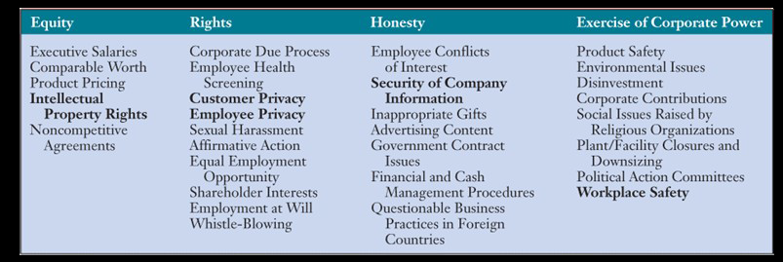
Categories of Ethical Business Issues

Slide 15
Security management of IT
Encryption
Firewalls
Denial of service attacks
E-mail monitoring
Virus defence
Security codes
Backup files
Security monitors
Biometric security
Computer failure controls
Fault tolerant systems
Disaster recovery
System controls and audits

Slide 16
Encryption
The concept of private key and public key can be extended to authentication protocols. There are three types of authentication protocols followed by organizations.
Password Authentication protocol
Challenge Handshake authentication Protocol
Extensible Authentication Protocol

Slide 17
Firewall
Firewalls are used to restrict access to one network from another network. Different types of firewalls exist.
Packet Filtering
Stateful firewalls
Proxy Firewalls
Kernel Proxy firewalls

Slide 18
Denial of Service Defences
The Internet is extremely vulnerable to variety of assaults by criminal hackers, especially denial of service (DOS) attacks.
Denial of service assaults via the Internet depend on three layers of networked computer systems, and
These are the basic steps e-business companies and other organizations can take to protect their websites form denial of service and other hacking attacks.

Slide 19
e-Mail Monitoring
Internet and other online e-mail systems are one of the favourite avenues of attack by hackers for spreading computer viruses or breaking into networked computers
E-mail is also the battleground for attempts by companies to enforce policies against illegal, personal, or damaging messages by employees, and the demands of some employees and others, who see such policies as violations of privacy rights.

Slide 20
Virus Defences
Many companies are building defences against the spread of viruses by centralizing the distribution and updating of antivirus software, as a responsibility of there IS departments.
Other companies are outsourcing the virus protection responsibility to their Internet service providers or to telecommunications or security management companies.

Slide 21
Security Codes
Typically, a multilevel password system is used for security management.
First, an end user logs on to the computer system by entering his or her unique identification code, or user ID.
The end user is then asked to enter a password in order to gain access into the system.
Next, to access an individual file, a unique file name must be entered.

Slide 22
Backup Files
Backup files, which are duplicate files of data or programs, are another important security measure.
Files can be protected by file retention measures that involve storing copies of files from previous periods.
Several generations of files can be kept for control purposes.

Slide 23
Biometric Security
These are security measures provided by computer devices, which measure physical traits that make each individual unique. This includes:
Voice verification
Fingerprints
Hand geometry
Signature dynamics
Keystroke analysis
Retina scanning
Face recognition
Genetic pattern analysis

